Slide 1
Quiz Application
-Key features and Outputs

Slide 2
Key Features
Teacher and Student Roles: The application supports two distinct roles - teachers and students. Teachers have exclusive access to functionalities like adding, updating, and deleting quiz questions, viewing individual student marks, and assessing overall student progress. Students, on the other hand, can take the quiz with a time limit for each question.
MySQL Database Integration: The application seamlessly integrates with a MySQL database to store quiz questions and student results. This ensures data integrity and efficient retrieval, allowing teachers to manage quiz content and review student performance effectively.
Quiz Management: Teachers can add new quiz questions to the database, update existing questions, and delete questions if necessary. This feature enables instructors to create customized quizzes tailored to the subject and level of difficulty.

Slide 3
4. Multiple-Choice Quiz Format: Students can attempt the quiz with multiple-choice questions. Each question is presented with several options, and students need to select the correct answer within the given time limit.
5. Randomizing of Questions: The application incorporates the feature of randomizing the order of quiz questions. Each time a student takes the quiz, the questions are presented in a random sequence, ensuring a unique and unbiased quiz experience for each student.
6. Time Limit Enforcement: The application incorporates a countdown timer for each question, ensuring that students complete the quiz within the specified time frame. The timer adds an element of challenge and urgency to the quiz-taking experience.

Slide 4
7. Quiz Result Storage and Retrieval: The application tracks and saves students' quiz results, allowing teachers to review individual student performance. Quiz scores, percentile, and grades are calculated and displayed on a comprehensive quiz certificate.
8. Text File Generation for Scorecard: After completing the quiz, the application generates a personalized scorecard for each student in the form of a text file. The scorecard includes the student's ID, name, total score, percentage, grade, and a summary of attempted quiz questions with their respective correct answers.
9. User-Friendly Interface: The application provides a user-friendly interface for both teachers and students, making it easy to navigate and interact with various functionalities.
10. Data Security: The application employs password authentication for teachers, ensuring secure access to quiz management features. Additionally, the integration with the MySQL database ensures the safe storage and retrieval of quiz data.

Slide 5
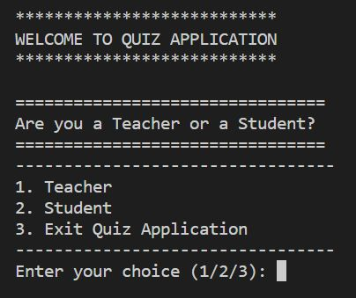
Outputs

Slide 6
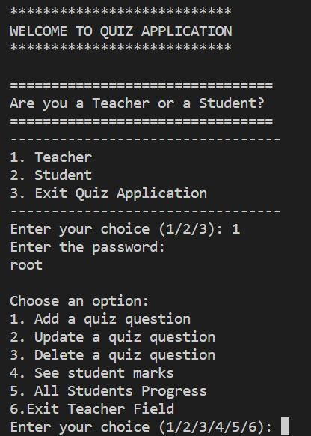
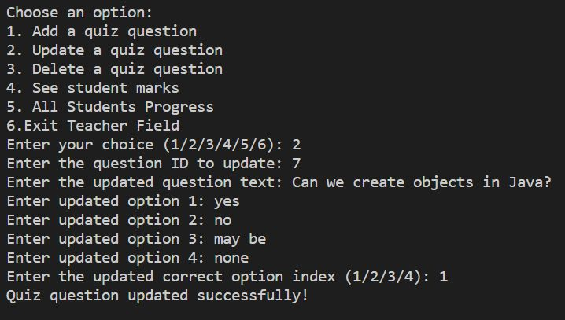
Teacher part:

Slide 7
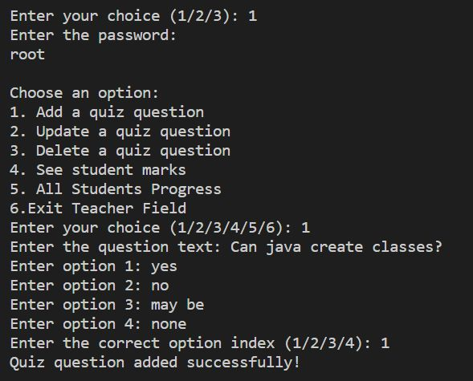

Slide 8
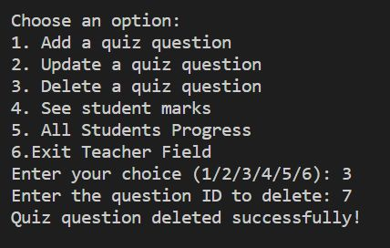
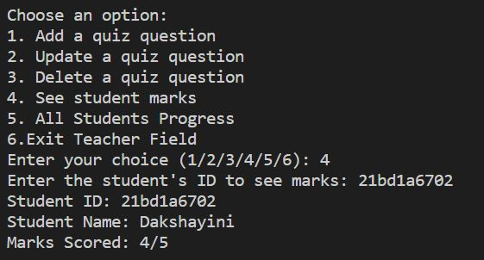

Slide 9
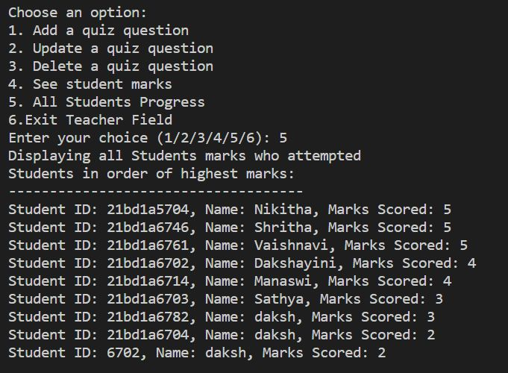
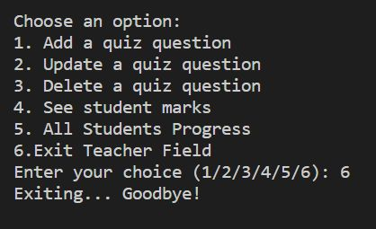

Slide 10
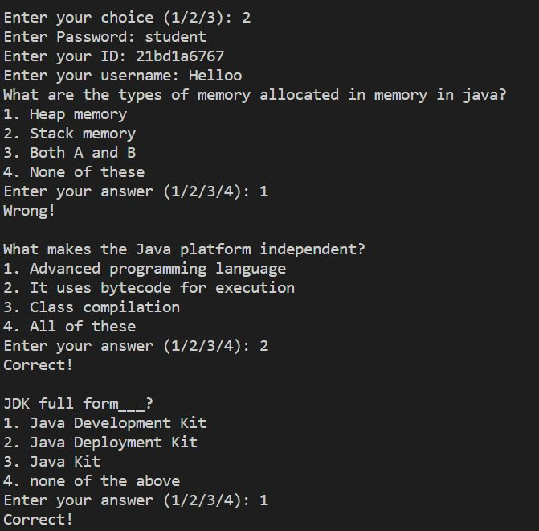
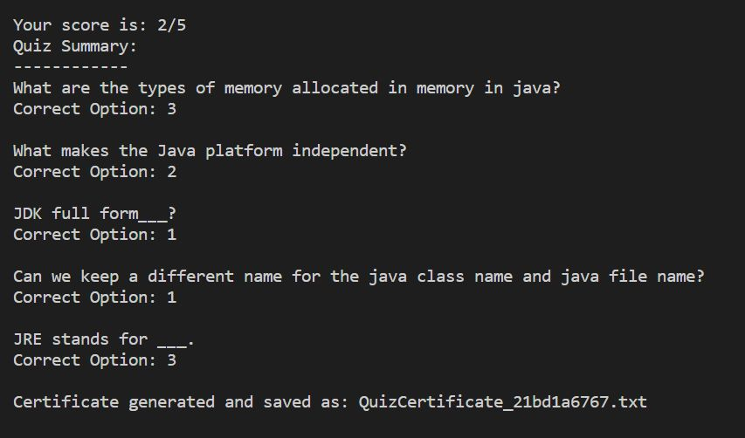
Student part:

Slide 11
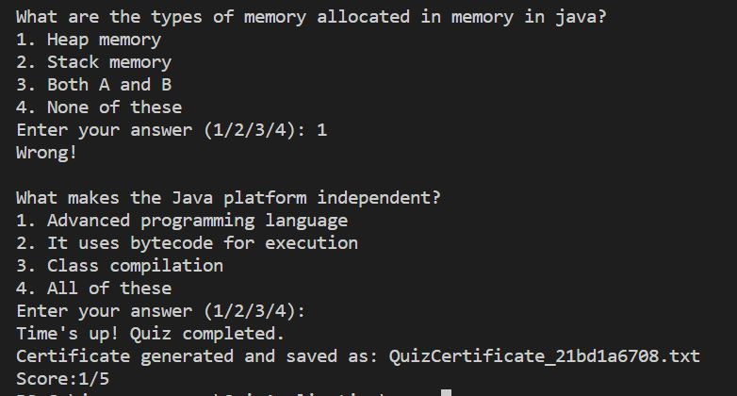
Quiz timer feature:

Slide 12
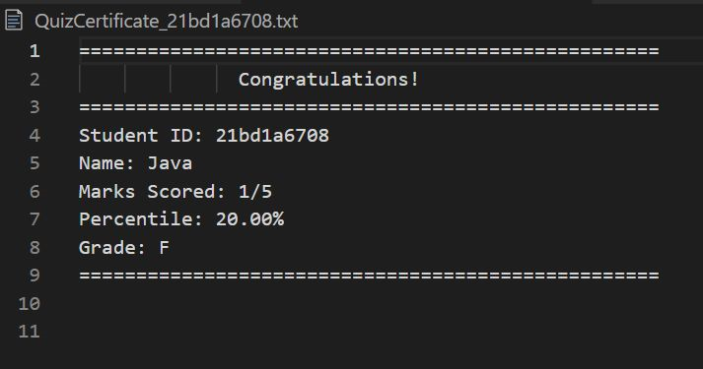
Text file generation for certificate:

Slide 13
Faculty:
Narsimhlu Sir, Java.
Team No. - 1
Team members:
V. Vaishnavi- 21bd1a6761
A.Dakshayini- 21bd1a6702
Ch. Manaswi- 21bd1a6714
P. Shritha- 21bd1a6746
Nikhitha- 22bd5a6704
A. Sathya Priya- 21bd1a6703

